Slide 1
Electron Transport Chain
The Four Complex Processes Involved

Slide 2
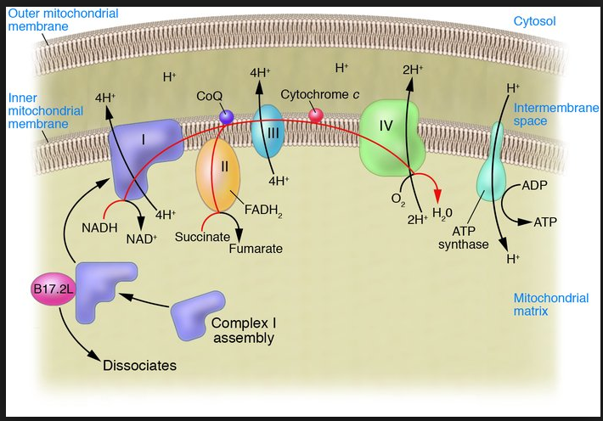
Complex I
Notes:
The process involves the pumping of hydrogen ions to intermembrane space.

Slide 3
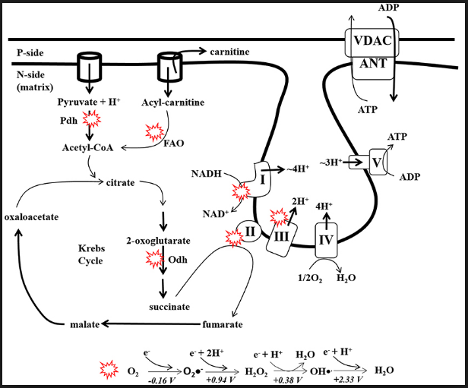
Complex II
Notes:
The complex entails transportation of electrons by the FADH2. The electrons enter the electron transport chain.

Slide 4
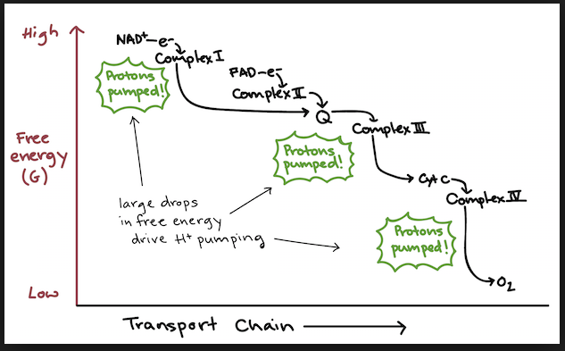
Cont...
Notes:
Once the particles and the four hydrogen ions reach the transport chain, Ubiquinone accepts and delivers them to complex III.

Slide 5
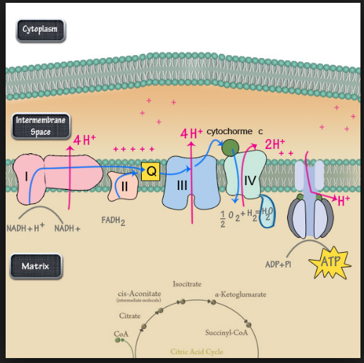
Complex III
Notes:
The complex involves pumping of protons across cell membrane and hands electrons to cytochrome for transport the final complex.

Slide 6
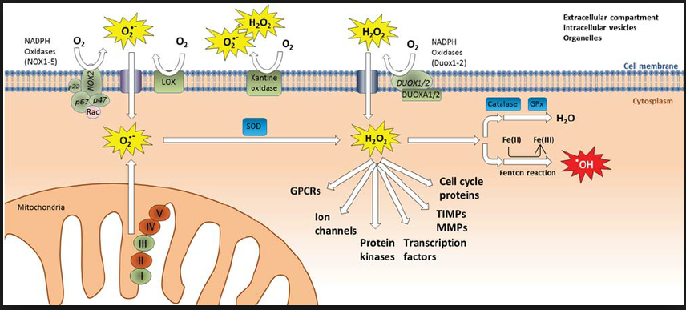
Complex IV
Notes:
The complex reduces atmospheric oxygen in the cell. The reduced oxygen then combines with two hydrogen ions to make water.

Slide 7
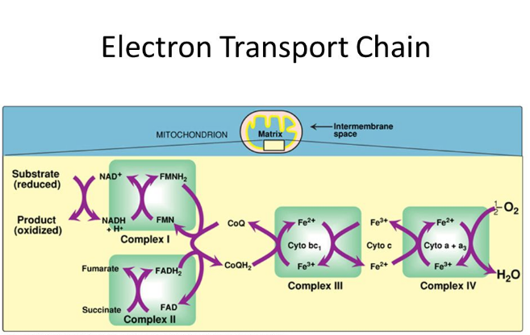
Overall process
Notes:
Each individual process does independent work but all of processes interconnect.

Slide 8
Reference
7.4A: Electron Transport Chain. (2019 June, 5). Retrieved June 12, 2019, from: https://bio.libretexts.org/Bookshelves/Introductory_and_General_Biology/Book%3A_General_Biology_(Boundless)/7%3A_Cellular_Respiration/7.4%3A_Oxidative_Phosphorylation/7.4A%3A_Electron_Transport_Chain

